Slide 1

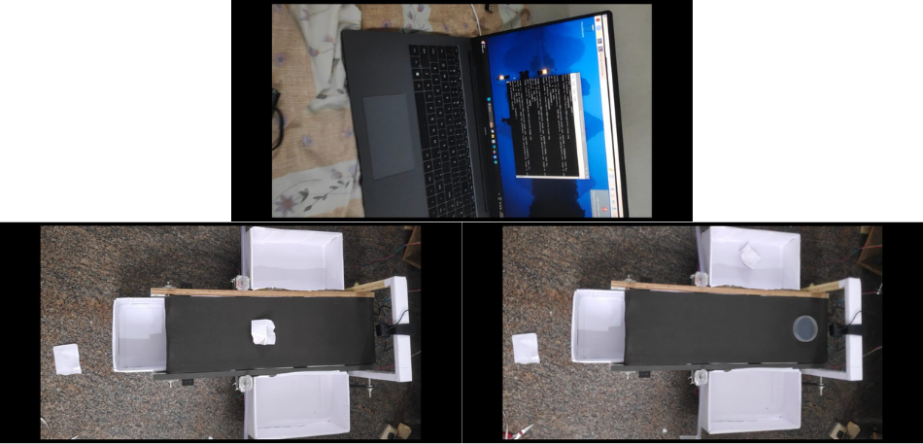
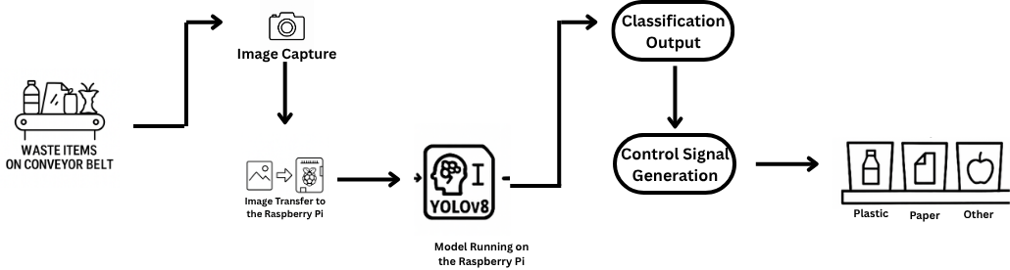
RV College of Engineering, Bengaluru – 560059.
Go, change the world
Title: AI Powered Waste Management System for Smart Cities
Ravikant | Sagar T Nayak | Shreyash Anant Mithare | Manoj Kumar B V | Nagaprasad Naik
1RV23EC408 | 1RV23EC410 | 1RV23EC411 | 1RV23CS407 | 1RV23CS410
Introduction
Tools used
Rapid urbanization has increased waste generation, and manual segregation methods are slow, unsafe, and ineffective.
While AI models like YOLOv4 and YOLOv5 have been used for waste classification, they often lack real-time performance and hardware-based physical sorting.
This project uses YOLOv8 to classify waste into plastic, paper, and other categories, and physically segregates them using a Raspberry Pi, camera, and motorized flaps for real-time smart bin applications
HARDWARE: Raspberry Pi 4 Model B, Pi Camera Module, Stepper Motors with Driver, Conveyor Belt System, Power Supply, Jumper Wires, GPIO Interface.
Python: Image preprocessing, YOLOv8 model training and testing, hardware control scripts.
Ultralytics YOLOv8: Used for real-time object detection and multi-class waste classification.
PyTorch: Backend framework for training the YOLOv8 models.
LabelIing: Used to annotate images and create custom dataset for training.
VS Code: Code development and testing for AI model and Raspberry Pi integration.
Raspberry Pi OS: Operating system for deploying scripts and controlling hardware.
Problem Definition
Manual waste segregation is slow, unsafe, and often inaccurate, leading to poor recycling. Existing AI models classify waste but rarely perform real-time physical sorting. There's a need for an automated system that can both detect and physically segregate plastic, metal, and other waste efficiently.
Results and Discussions
Objectives
The YOLOv8 model achieved in classifying plastic, paper, and other waste categories, with an average detection and sorting time.
The system showed good hardware response accuracy during real-time testing, confirming its effectiveness and suitability for automated waste segregation applications when compared to earlier YOLOv4 and YOLOv5 models.
To design and build a conveyor-based setup for controlled movement of waste items.
To collect, label, and train a custom YOLOv8 model for classifying waste into plastic, metal, and other categories.
To deploy the trained model on embedded hardware (Raspberry Pi) for real-time waste detection.
To automate physical segregation using stepper motor–controlled flaps based on model predictions.
To reduce manual effort and enhance safety, accuracy, and efficiency in urban waste management, supporting smart city and SDG 11 goals.
Methodology
Yolov8 model for Waste Management System
Waste Items on Conveyor Belt: Waste materials move along a conveyor belt for sorting.
Image Capture: A camera takes pictures of the waste items on the belt.
Image Transfer to Raspberry Pi: The captured images are sent to a Raspberry Pi for processing.
Model Running on the Raspberry Pi (YOLOv8): The YOLOv8 model analyzes the images to identify and classify the waste types.
Classification Output: The system determines the category of each waste item (e.g., plastic, paper, other).
Control Signal Generation: Signals are generated to control the sorting mechanism based on the classification.
Segregated Bins: Waste items are automatically sorted into the correct bins (plastic, paper, other).
Conclusions
The proposed system successfully detects and classifies waste into plastic, paper, and other categories using YOLOv8 and physically segregates them using motor-controlled flaps. It improves accuracy, reduces manual effort, and supports real-time waste sorting. The project demonstrates how AI and automation can enhance waste management efficiency, making it suitable for smart city applications aligned with SDG 11.
References
S. R. Nambiar, C. Shibijith, B. Kishore, G. Krishna, and K. Rashida, “Deep learning based object classification for waste management in smart cities,” in Proc. 2nd Int. Conf. Trends in Engineering Systems and Technologies (ICTEST), 2025.
S. Rathod, A. Panchal, D. Sheth, K. Gami, and H. Thakkar, “Intelligent waste sorting system using deep learning,” in Int. J. Adv. Comput. Sci. Appl. (IJACSA), vol. 14, no. 2, pp. 23–29, 2024.
R. Tripathi, S. Sinha, M. Goel, and A. Choubey, “E-Safe: An E-waste management and awareness application using YOLO object detection,” in Proc. 3rd Int. Conf. Smart Computing and Cyber Security, 2024.
Signature of the Co-Ordinator
Dr. Sujatha D Badiger
Assistant Professor
Signature of the Co-Ordinator
Dr. Rajani Katiyar
Assistant Professor

